Slide 1

Madrid Training School
Digging for Gold: Knowledge Extraction From Text
This project has received funding from the European Union’s Horizon 2020 research and innovation programme under grant agreement No 101004984

Slide 2
Vector Semantics & Embeddings
Javier de la Rosa, versae@nb.no National Library of Norway
This project has received funding from the European Union’s Horizon 2020 research and innovation programme under grant agreement No 101004984

Slide 3

Vector Semantics & Embeddings
Part 1. Background.
Part 2. Practical case. Attribution of Austen and Chesterton.
Emma

Slide 4

Vector Semantics & Embeddings
https://bit.ly/clsinfra_embeddings
Part 1. Background.
Part 2. Practical case. Attribution of Austen and Chesterton.
Emma

Slide 5
https://bit.ly/clsinfra_embeddings

Slide 6
Embeddings & Literary Studies
Embedding spaces and computational literary studies have emerged as a fruitful convergence of computer science and literary analysis. This presentation introduces the concept of embedding spaces, which represent textual data as high-dimensional vectors, capturing semantic relationships and contextual information. Specifically, word embeddings enable tasks such as sentiment analysis and authorship attribution, while sentence and document embeddings facilitate analysis at larger text units. By leveraging computational methods, researchers can delve into the complexities of literature, offering quantitative insights and novel research avenues. This interdisciplinary approach holds great promise for revolutionizing the study of literature and deepening our understanding of its intricacies.
Notes:
First, before getting into the details, I’d like to read out loud a small intro I wrote..

Slide 7
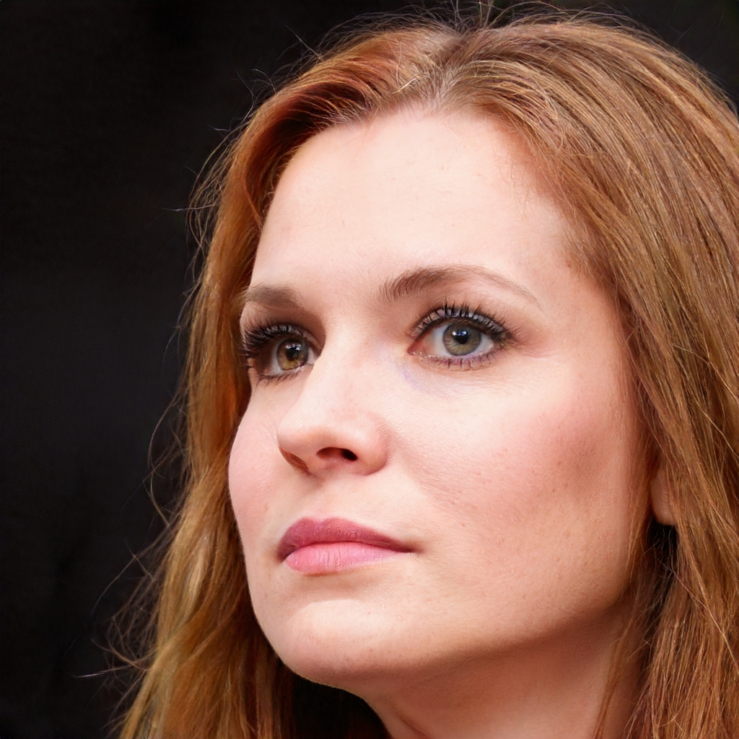

Una donna by Rebecca Marshall
Io sono una donna e cammino per la strada con la testa alta e il cuore aperto agli altri e alla vita. Io sono una donna e mi piace la vita come una bella canzone che mi fa ballare e mi fa sognare. Io sono una donna e sono forte e sono fragile e sono bella come la vita stessa.
I am a woman and I walk down the street with your head held high and an open heart to the others and to life. I am a woman and i like life like a good song that makes me dance and makes me dream. I am a woman and I'm strong and I'm fragile and I'm beautiful like life itself.
Notes:
Keep that in mind. And now let me show you this poem by American-born Italian poet Rebeca Marshall… Is there anything strange there?

Slide 8

Una donna by Rebecca Marshall
Io sono una donna e cammino per la strada con la testa alta e il cuore aperto agli altri e alla vita. Io sono una donna e mi piace la vita come una bella canzone che mi fa ballare e mi fa sognare. Io sono una donna e sono forte e sono fragile e sono bella come la vita stessa.
I am a woman and I walk down the street with your head held high and an open heart to the others and to life. I am a woman and i like life like a good song that makes me dance and makes me dream. I am a woman and I'm strong and I'm fragile and I'm beautiful like life itself.
Notes:
Well, there is

Slide 9
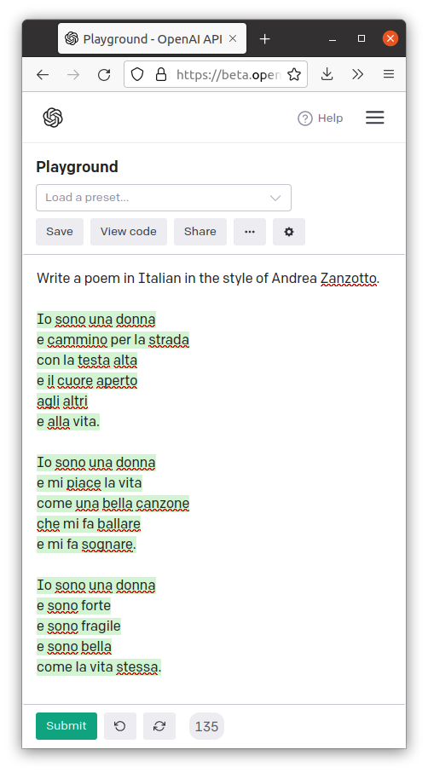

Slide 10
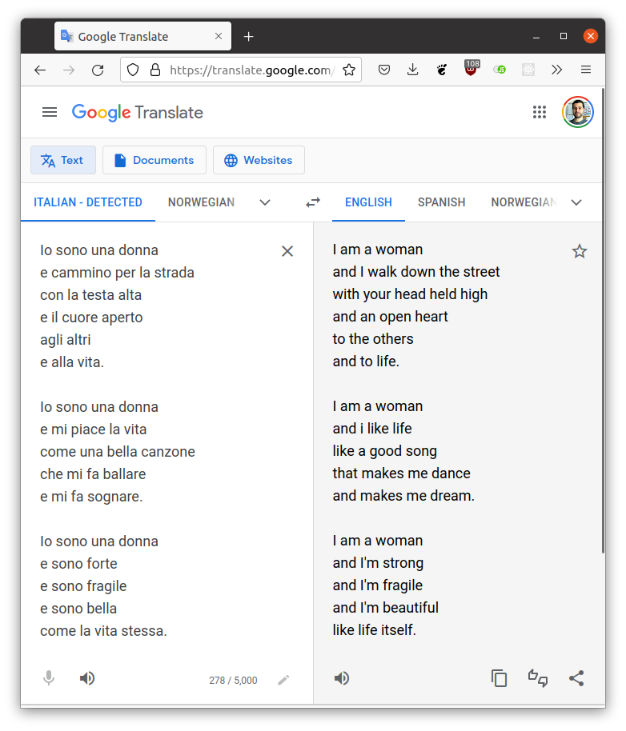

Slide 11


Slide 12
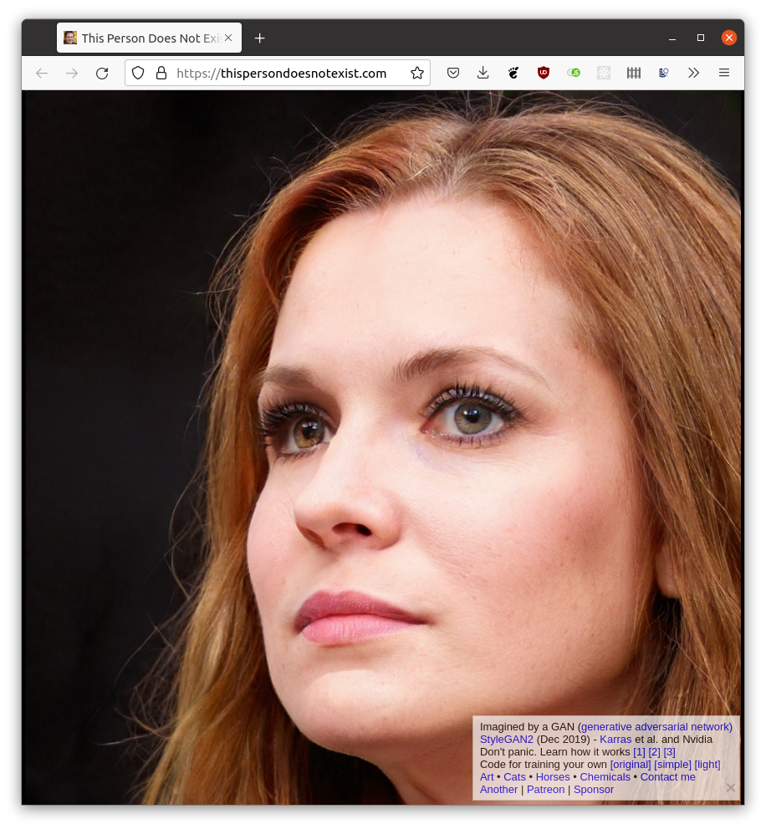

Slide 13
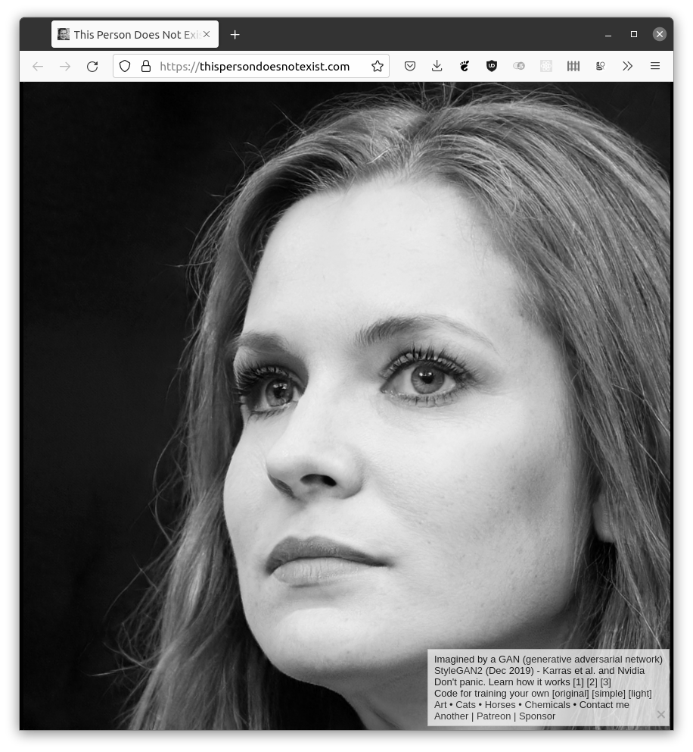
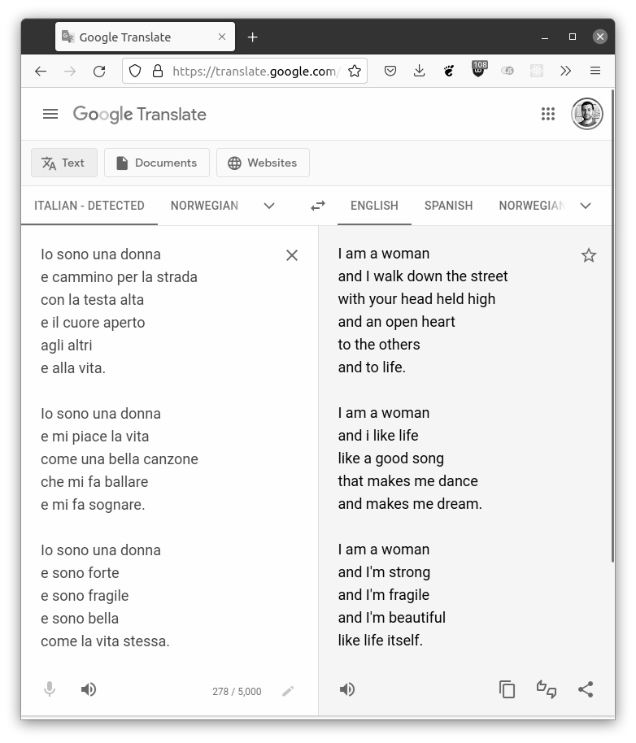
Decoder-only autoregressive model

Slide 14
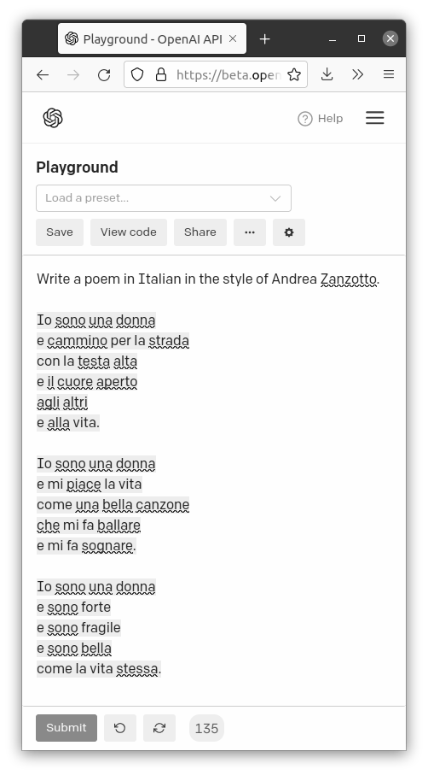

Encoder-decoder model (seq2seq)

Slide 15
Generative Adversarial Network (GAN)

Slide 16
Embeddings & Literary Studies
Embedding spaces and computational literary studies have emerged as a fruitful convergence of computer science and literary analysis. This presentation introduces the concept of embedding spaces, which represent textual data as high-dimensional vectors, capturing semantic relationships and contextual information. Specifically, word embeddings enable tasks such as sentiment analysis and authorship attribution, while sentence and document embeddings facilitate analysis at larger text units. By leveraging computational methods, researchers can delve into the complexities of literature, offering quantitative insights and novel research avenues. This interdisciplinary approach holds great promise for revolutionizing the study of literature and deepening our understanding of its intricacies.
Notes:
First, before getting into the details, I’d like to read out loud a small intro I wrote..

Slide 17
Embeddings & Literary Studies
Embedding spaces and computational literary studies have emerged as a fruitful convergence of computer science and literary analysis. This presentation introduces the concept of embedding spaces, which represent textual data as high-dimensional vectors, capturing semantic relationships and contextual information. Specifically, word embeddings enable tasks such as sentiment analysis and authorship attribution, while sentence and document embeddings facilitate analysis at larger text units. By leveraging computational methods, researchers can delve into the complexities of literature, offering quantitative insights and novel research avenues. This interdisciplinary approach holds great promise for revolutionizing the study of literature and deepening our understanding of its intricacies.
Decoder-only autoregressive model!
(GPT3.5)
Notes:
First, before getting into the details, I’d like to read out loud a small intro I wrote..

Slide 18
How did we get this far?
?

Slide 19
How did we get this far?
Why should I care?
?

Slide 20
Natural Language Processing
Stylometry
Machine Learning
Digital Humanities
Notes:
There are many moving parts at work here. In my case, I work at the intersection of…

Slide 21

Natural Language Processing
CLS
Stylometry
Machine Learning
Digital Humanities
Notes:
And while this is very exciting…

Slide 22
CLS
Natural Language Processing
Stylometry
Machine Learning
Digital Humanities
Statistics
Literature
Calculus
Programming
Linguistics
Notes:
It also means there’s a great deal that I don’t know about. It’s impossible to master everything.

Slide 23
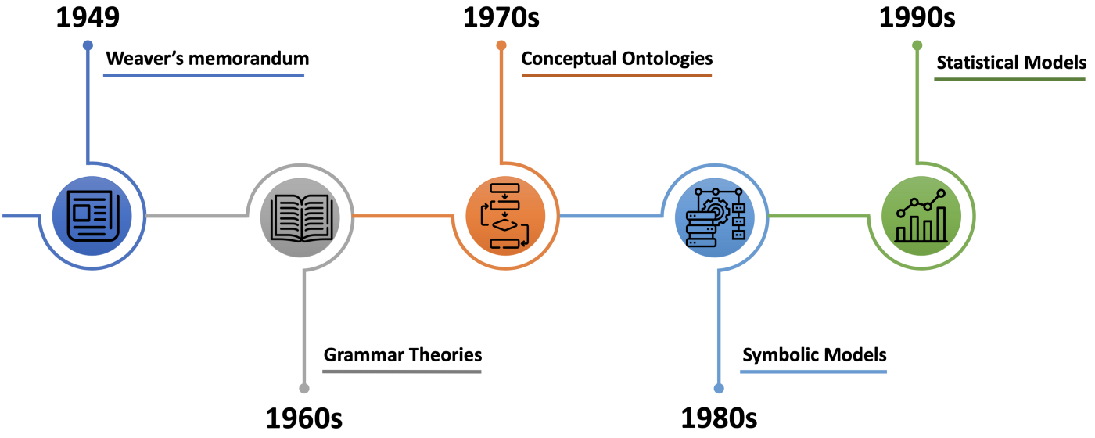
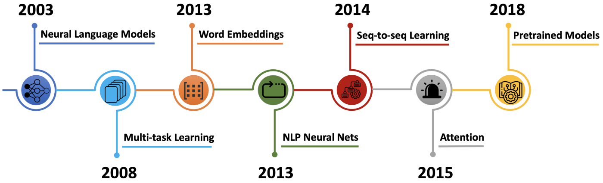
A brief history of NLP
Source: A Brief History of Natural Language Processing
Notes:
If for example we trace a temporal line for the major events in NLP we might have to start by mentioning the Weaver’s memorandum in which Shannon and Weaver brought the idea of machine translation for the first time ever.

Slide 24
A brief history of NLP
Source: A Brief History of Natural Language Processing
Notes:
This is the part I’ll be focusing since that was the part I had to live through

Slide 25
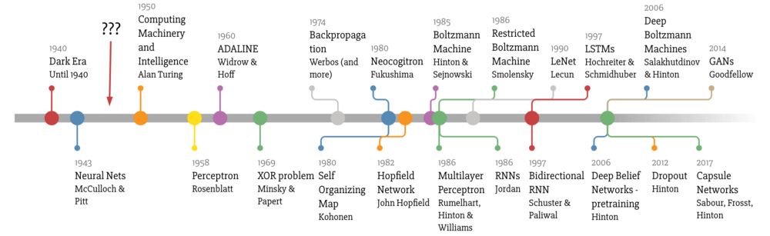
A brief history of Machine Learning
Source: Deep Learning Timeline
Notes:
But the timeline of NLP is very tightly coupled with that of the Machine Learning or even AI.

Slide 26
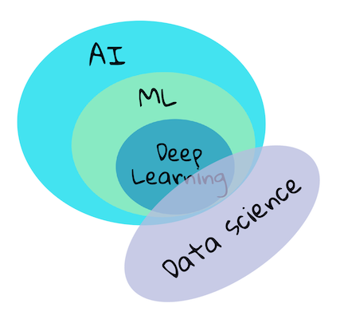
A brief history of…
Source: ML For Beginners
Notes:
In fact, ML is technically a branch of AI, and DL is a branch of ML, with Data Science overlapping the three. And DL is probably the cause of all the fuzz about AI we’ve been living in recent years.

Slide 27
A brief history of Machine Learning
AI Winters
1973
1980
1987
1993
Source: Deep Learning Timeline
Notes:
But it wasn’t always like that. If we attend to the timeline, the history of AI has experienced what they call summers and winters… We are now in a very intense AI Spring/Summer.

Slide 28
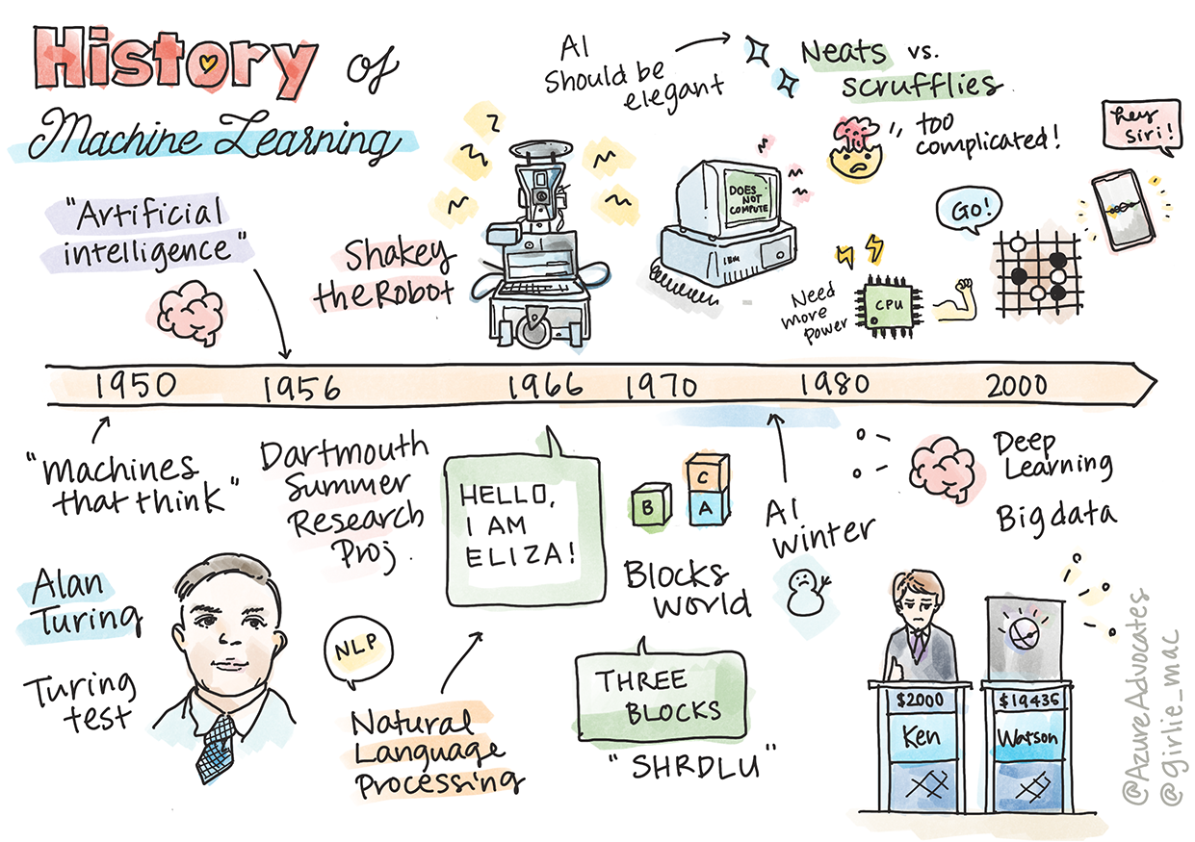
Notes:
The reality is that events and progress do not happen in isolation

Slide 29
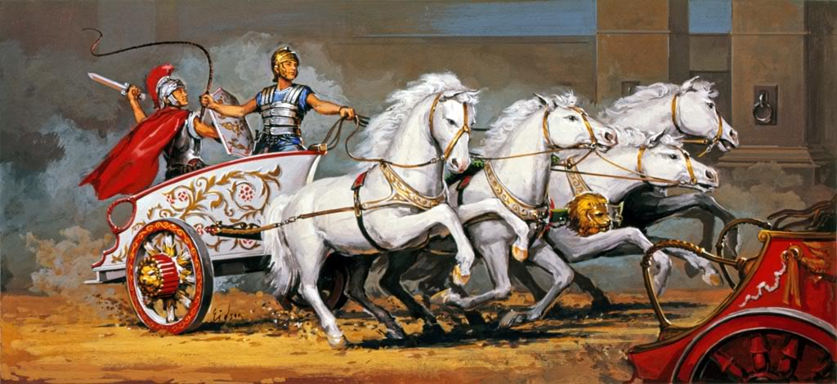
Digital Humanities
Stylometry
NLP
Machine Learning
Notes:
Personally, given the context in which I started my own research career, I like to see it a lot like this. This is not especially accurate or anything, but it links very well with my own experience and drift between fields. I consider myself an outsider in all of them, and that gives me great freedom, at the cost of not finding any department that wants to hire me LOL. So, yeah, be careful being the hybrid interdisciplinary scholar.

Slide 30
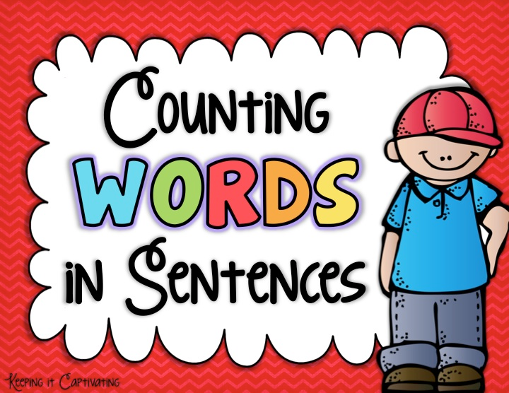
It all started
with…
Notes:
For me, it all started counting words. As such, I’ll start with my own timid approaches to stylometry.

Slide 31
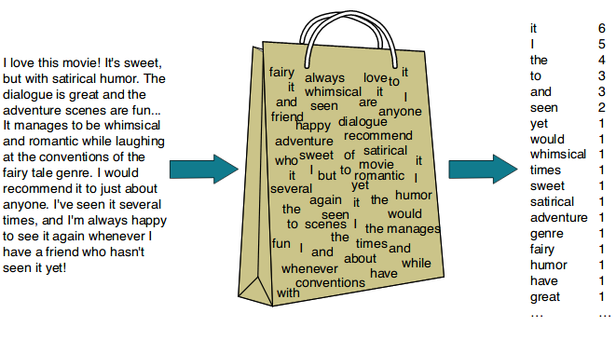
From string of characters to numbers
Bag of Words (BoW)

Slide 32
From string of characters to numbers
Bag of Words (BoW)
Vector Space Model ✅
Classification ✅

Slide 33
From string of characters to numbers
Bag of Words (BoW)
Vector Space Model ✅
Classification ✅
Sparsity ❌
Semantics ❌

Slide 34
From string of characters to numbers
Word2Vec

Slide 35
From string of characters to numbers
Word2Vec
“Words that occur in the same contexts tend to have similar meanings”
– The Distributional Hypothesis, Z. Harris, 1954

Slide 36
From string of characters to numbers
Word2Vec
“Words that occur in the same contexts tend to have similar meanings”
– The Distributional Hypothesis, Z. Harris, 1954
“A word is characterized by the company it keeps”
– J.R. Firth, 1957

Slide 37
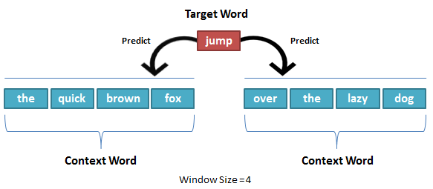
From string of characters to numbers
Word2Vec
Source: https://thinkinfi.com/word2vec-skip-gram-explained/

Slide 38
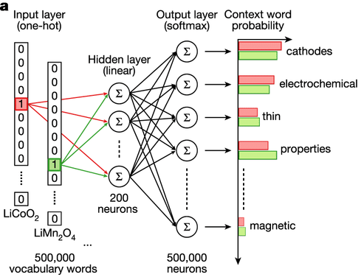

From string of characters to numbers
first
winner
loser
cars
 | ??? | ??? | ??? | … | ???
brave | 0.55 | 1.3 | 6.3 | 0.1 | 0.2
victory | 0.6 | 6.2 | 3.2 | 0.1 | 0.36
breakup | 0.95 | 0.75 | 0.63 | 0.74 | 0.3
pup | 0.12 | 0.3 | 0.8 | 1.0 | 0.1
victory
brave
Notes:
The intuition of word2vec is that instead of counting how often each word w oc- curs near, say, apricot, we’ll instead train a classifier on a binary prediction task: “Is word w likely to show up near apricot?” We don’t actually care about this prediction task; instead we’ll take the learned classifier weights as the word embeddings. The revolutionary intuition here is that we can just use running text as implicitly supervised training data for such a classifier; a word c that occurs near the target word apricot acts as gold ‘correct answer’ to the question “Is word c likely to show up near apricot?” This method, often called self-supervision, avoids the need for any sort of hand-labeled supervision signal. This idea was first proposed in the task of neural language modeling, when Bengio et al. (2003) and Collobert et al. (2011) showed that a neural language model (a neural network that learned to predict the next word from prior words) could just use the next word in running text as its supervision signal, and could be used to learn an embedding representation for each word as part of doing this prediction task. word2vec is a much simpler model than the neural network language model, in two ways. First, word2vec simplifies the task (making it binary classification instead of word pre- diction). Second, word2vec simplifies the architecture (training a logistic regression classifier instead of a multi-layer neural network with hidden layers that demand more sophisticated training algorithms)

Slide 39
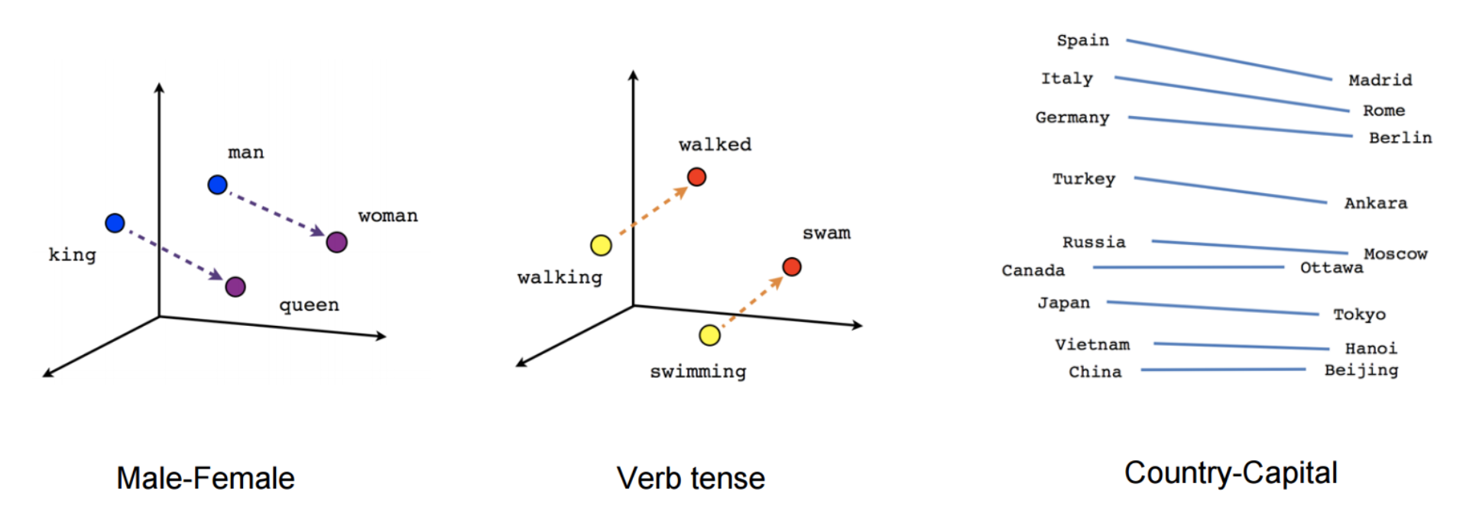
From string of characters to numbers
Word2Vec
Source: https://thegradient.pub/nlp-imagenet/

Slide 40
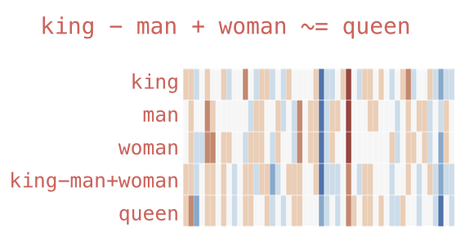
From string of characters to numbers
Word2Vec
Source: http://jalammar.github.io/illustrated-word2vec/

Slide 41
From string of characters to numbers
Word2Vec
Sparsity ✅
Semantics ✅

Slide 42
From string of characters to numbers
Word2Vec
Sparsity ✅
Semantics ✅
Similarity ✅
Document level ❌
Polysemy ❌

Slide 43
From string of characters to numbers
Doc2Vec
Corpus of documents
Model learns a numerical representation for each document (training)
Model is able to generate representations for unseen documents (inference)
Each representation contains values that “embed” the document
Document embeddings!

Slide 44
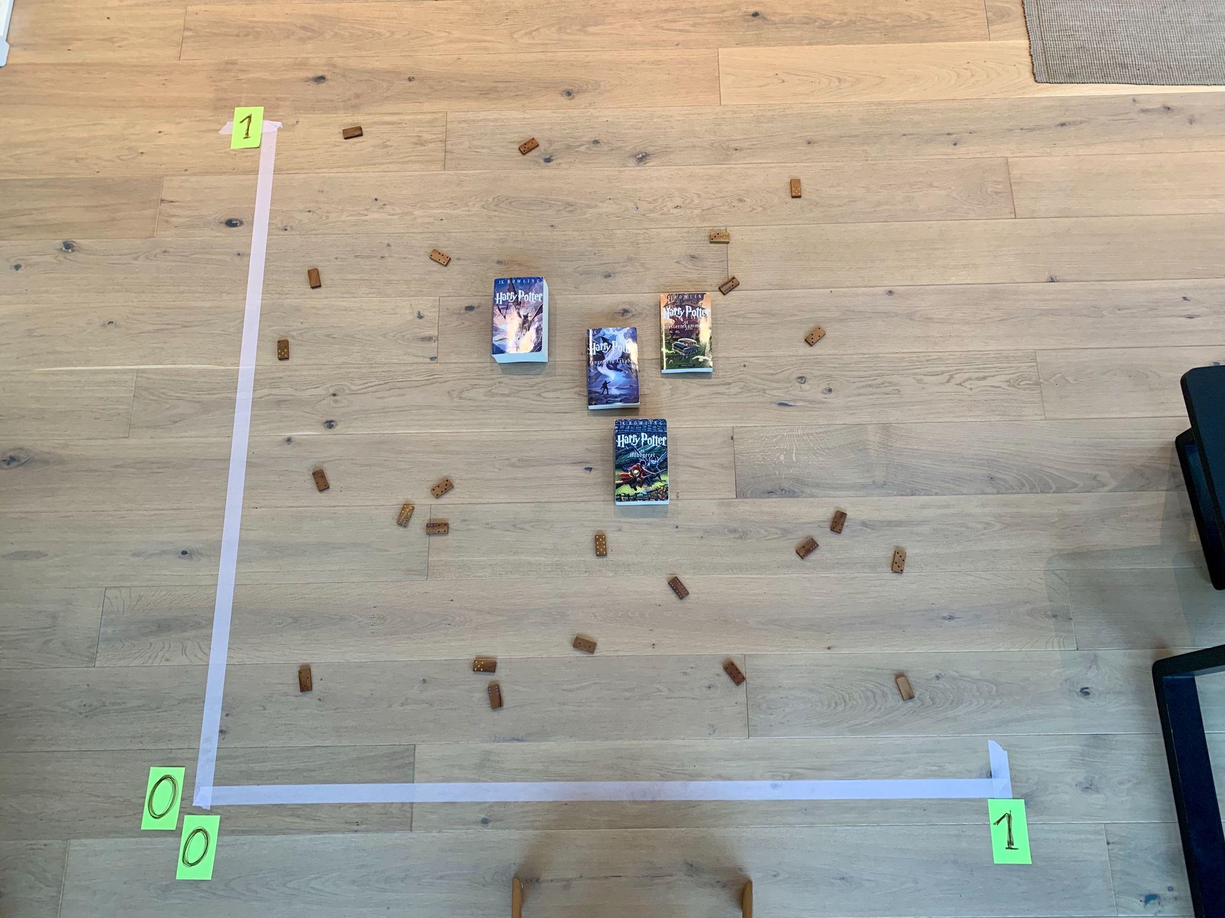
From string of characters to numbers
Photo: Jørgen Schyberg
Embeddings are “close” to each other when documents are “semantically” similar

Slide 45

Searching for similarities
Find an object, book or image

Slide 46
Searching for similarities
Find an object, book or image
Get its numerical representation
{0.9, 0.12, 0.45, …}

Slide 47
Searching for similarities
Find an object, book or image
Get its numerical representation
Compare to the numerical representation of all the other objects
{0.9, 0.12, 0.45, …}
{0.1, 0.23, 0.27, …}
{0.2, 0.56, 0.87, …}
{0.9, 0.78, 0.62, …}
{0.6, 0.29, 0.32, …}
{0.9, 0.26, 0.79, …}
{0.9, 0.69, 0.16, …}
{0.8, 0.82, 0.87, …}
{0.5, 0.35, 0.10, …}
{0.3, 0.72, 0.97, …}
…
{0.9, 0.12, 0.45, …}

Slide 48
Searching for similarities
Find an object, book or image
Get its numerical representation
Compare to the numerical representation of all the other objects
Rank by the comparison metric
{0.9, 0.12, 0.45, …} → 0.9
{0.1, 0.23, 0.27, …} → 0.1
{0.2, 0.56, 0.87, …} → 0.2
{0.9, 0.78, 0.62, …} → 0.8
{0.6, 0.29, 0.32, …} → 0.4
{0.9, 0.26, 0.79, …} → 0.7
{0.9, 0.69, 0.16, …} → 0.1
{0.8, 0.82, 0.87, …} → 0.1
{0.5, 0.35, 0.10, …} → 0.2
{0.3, 0.72, 0.97, …} → 0.4
…
{0.9, 0.12, 0.45, …}

Slide 49



Searching for similarities
Find an object, book or image
Get its numerical representation
Compare to the numerical representation of all the other objects
Rank by the comparison metric
{0.9, 0.12, 0.45, …} → 0.9
{0.1, 0.23, 0.27, …} → 0.1
{0.2, 0.56, 0.87, …} → 0.2
{0.9, 0.78, 0.62, …} → 0.8
{0.6, 0.29, 0.32, …} → 0.4
{0.9, 0.26, 0.79, …} → 0.7
{0.9, 0.69, 0.16, …} → 0.1
{0.8, 0.82, 0.87, …} → 0.1
{0.5, 0.35, 0.10, …} → 0.2
{0.3, 0.72, 0.97, …} → 0.4
…
{0.9, 0.12, 0.45, …}

Slide 50
A brief history of NLP
Source: A Brief History of Natural Language Processing
Notes:
The year is 2013, and the pace of research in NLP is just starting to accelerate

Slide 51
From string of characters to numbers
Word2Vec
Sparsity ✅
Semantics ✅
Similarity ✅
Polysemy ❌
Notes:
Previously, I mentioned how these methods were lacking polysemy. Or more precisely, they were collapsing all meanings into a single representation.

Slide 52
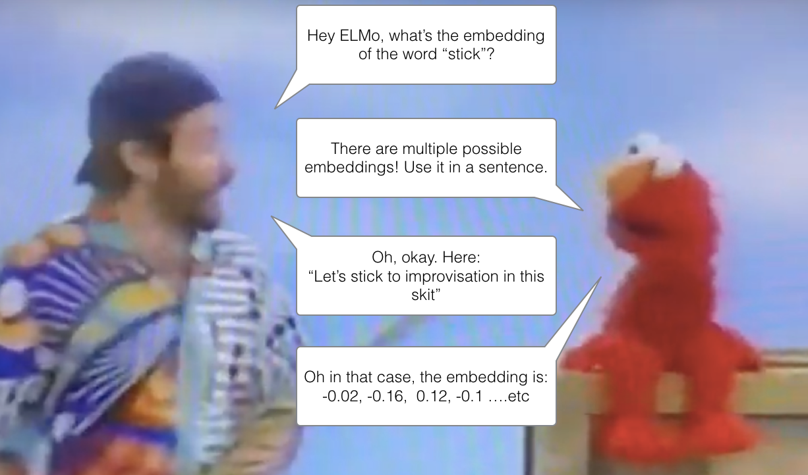
ELMo: context matters!
Source: Illustrated BERT

Slide 53
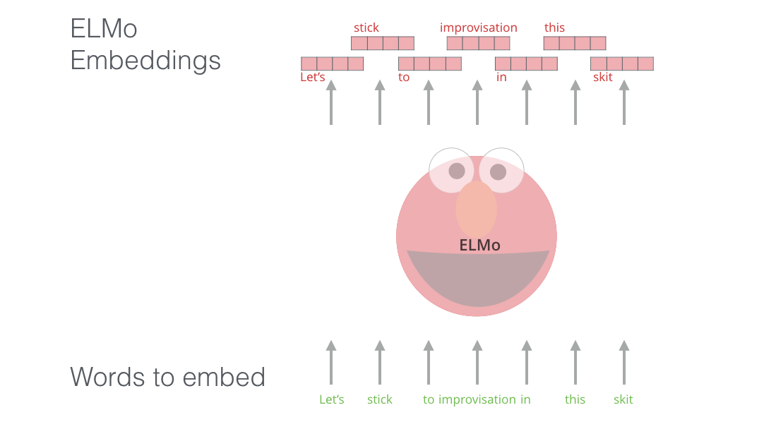
ELMo: context matters!
Source: Illustrated BERT

Slide 54
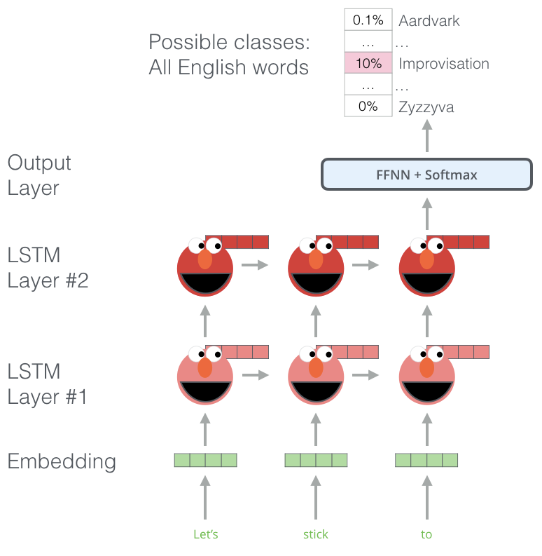
ELMo: context matters!
Language modelling
What’s the next word?
Massive dataset
Reusable component
Source: Illustrated BERT

Slide 55
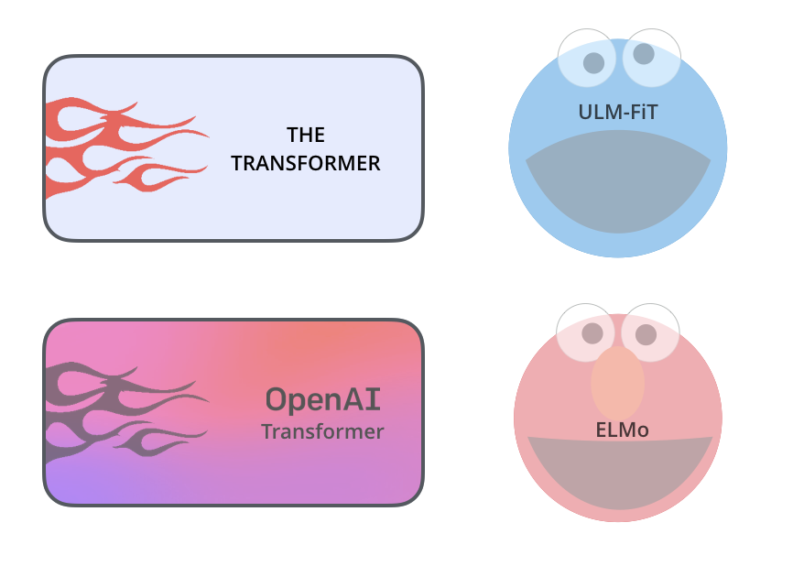
Source: Illustrated BERT
Notes:
ELMo was the first in a series of key milestones in NLP. ULM-Fit provided a way to effectively reuse an already pre-trained model for a different task. And the OpenAI Transformer used the Transformer architecture for language modelling using in a decoder only way

Slide 56

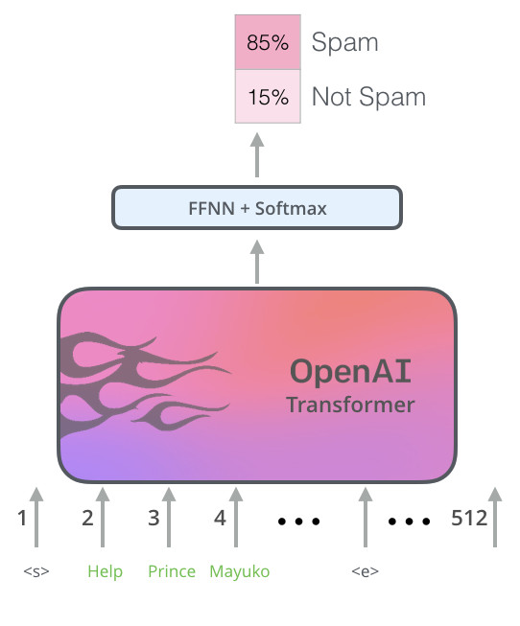
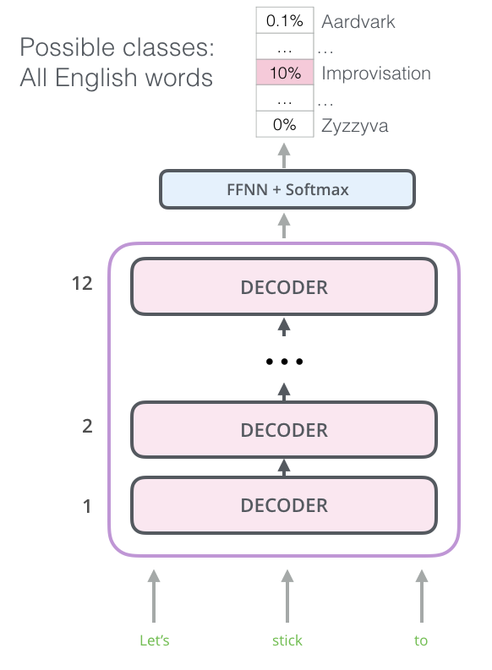
Source: Illustrated BERT
Notes:
ELMo was the first in a series of key milestones in NLP. ULM-Fit provided a way to effectively reuse an already pre-trained model for a different task. And the OpenAI Transformer used the Transformer architecture for language modelling using in a decoder only way

Slide 57
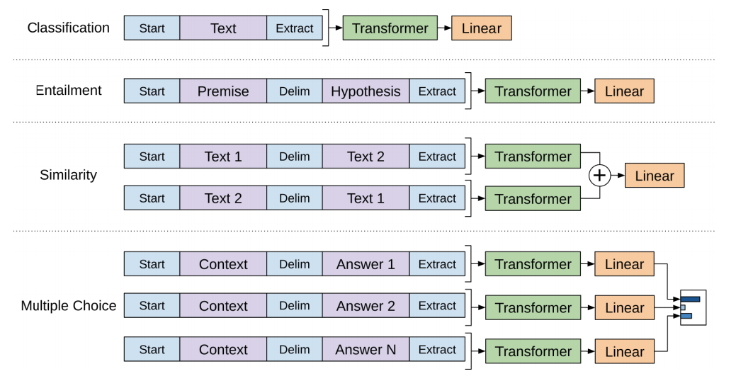
Source: Illustrated BERT

Slide 58

Notes:
Then, BERT appeared into the scene consolidating several of this approaches and revolutionized NLP.

Slide 59
BERT
Bidirectional Encoder Representations from Transformers
Notes:
Then, BERT appeared into the scene consolidating several of this approaches and revolutionized NLP.

Slide 60
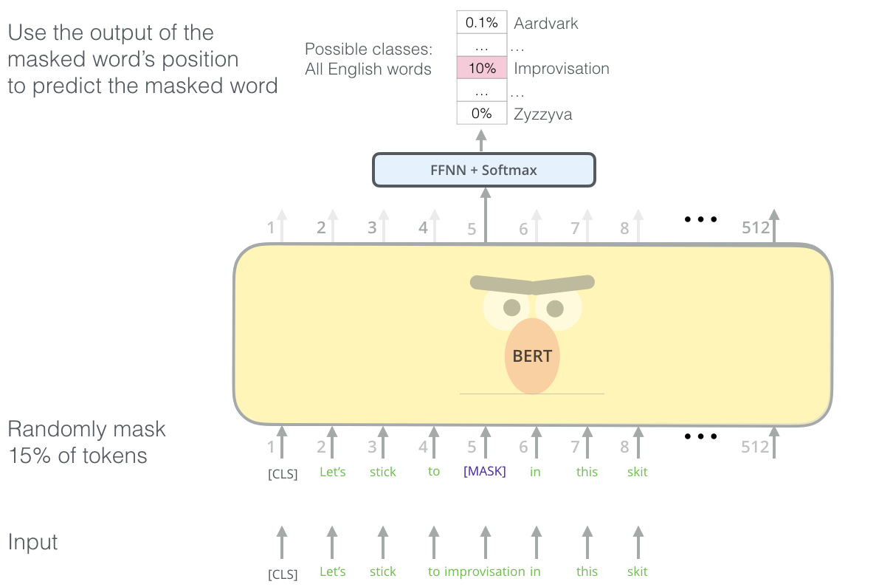
BERT
Masked Language Modeling
Source: Illustrated BERT
Notes:
Then, BERT appeared into the scene consolidating several of this approaches and revolutionized NLP.

Slide 61
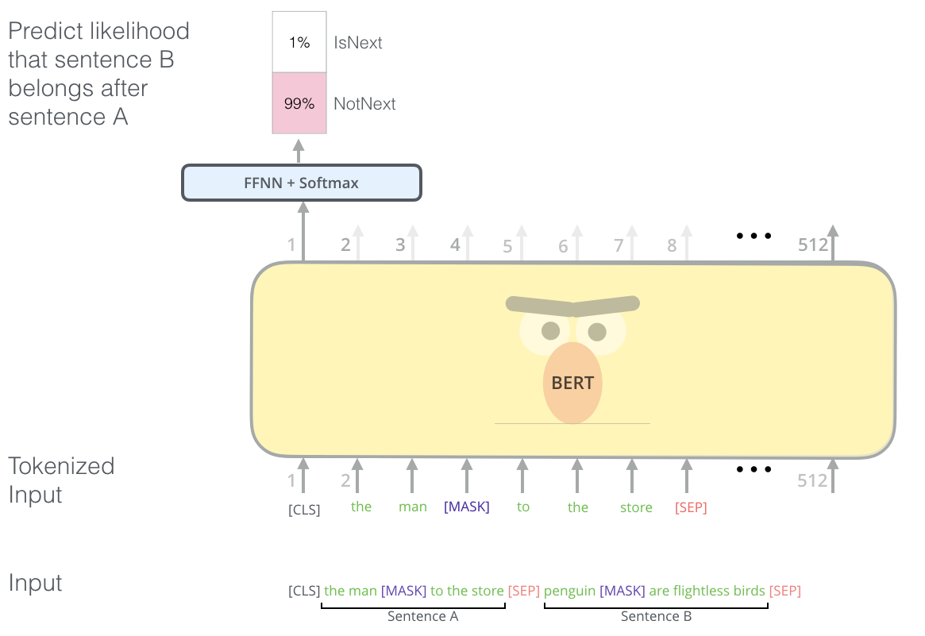
BERT
Next Sentence Prediction
Source: Illustrated BERT
Notes:
Then, BERT appeared into the scene consolidating several of this approaches and revolutionized NLP.

Slide 62
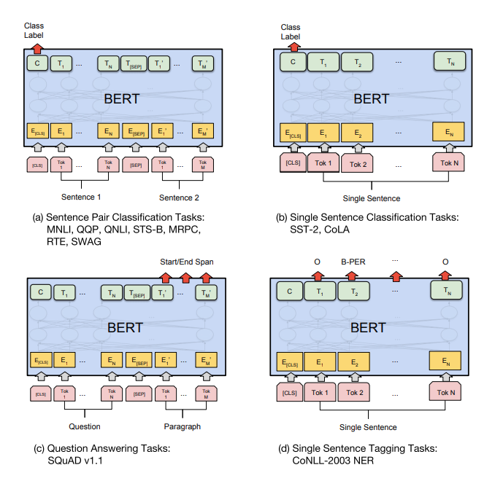
BERT
Encoder only
Fine-tuning
Language understanding tasks
Source: Illustrated BERT
Notes:
Then, BERT appeared into the scene consolidating several of this approaches and revolutionized NLP.

Slide 63
What kind of tasks?
Classification
At the word level (token)
At the sentence level (sequence)

Slide 64
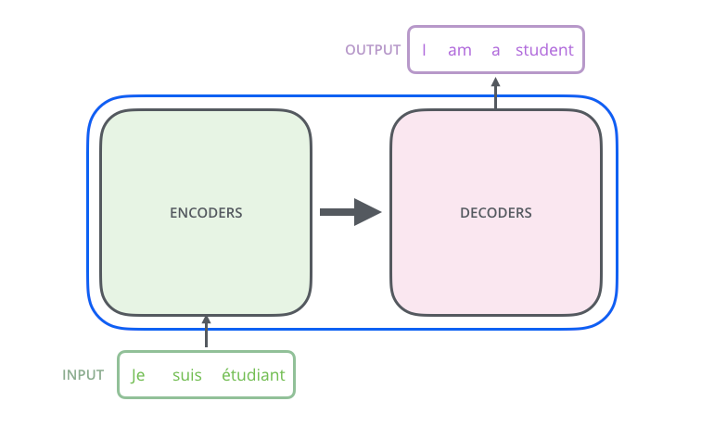
Sequence to sequence
Source: Illustrated BERT

Slide 65
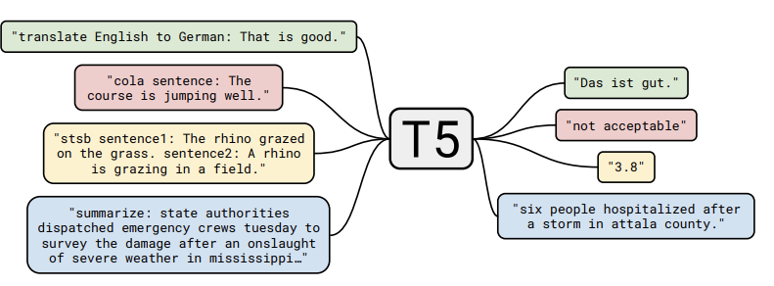
T5: Text-To-Text Transfer Transformer
Source: Text-to-Text Transfer Transformer

Slide 66
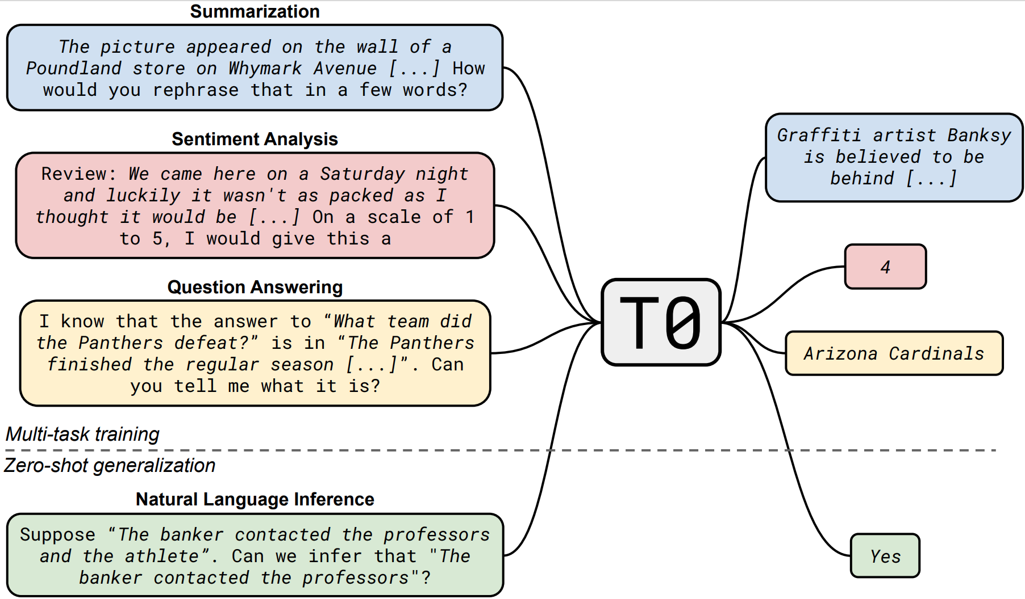
Prompting!
Source: The Tale of T0

Slide 67
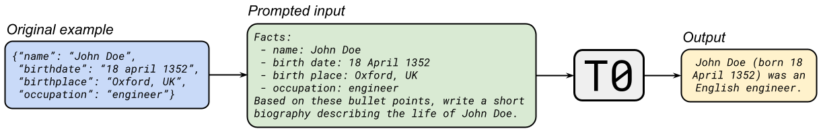
Prompting!
Source: The Tale of T0

Slide 68
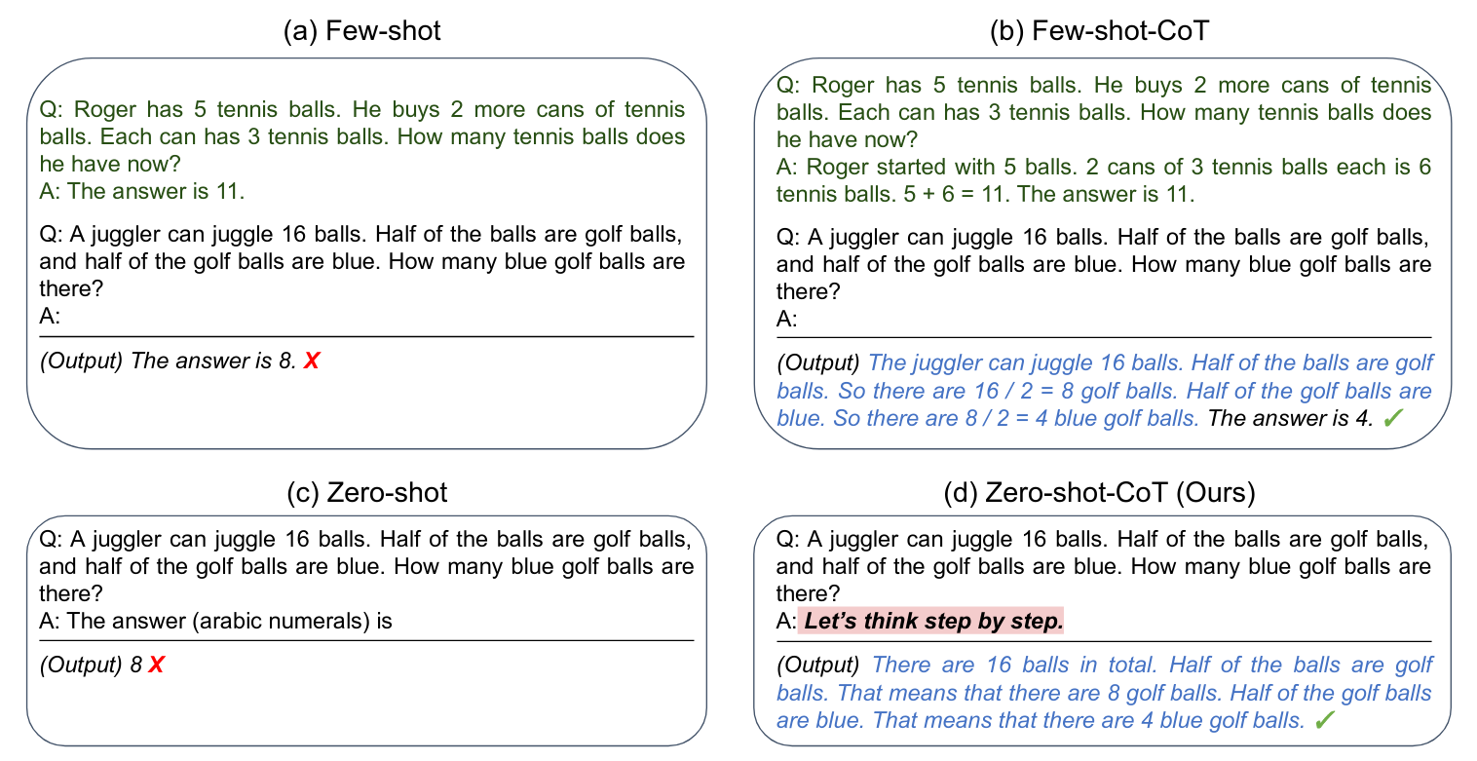
Prompting!
Source: The Tale of T0

Slide 69
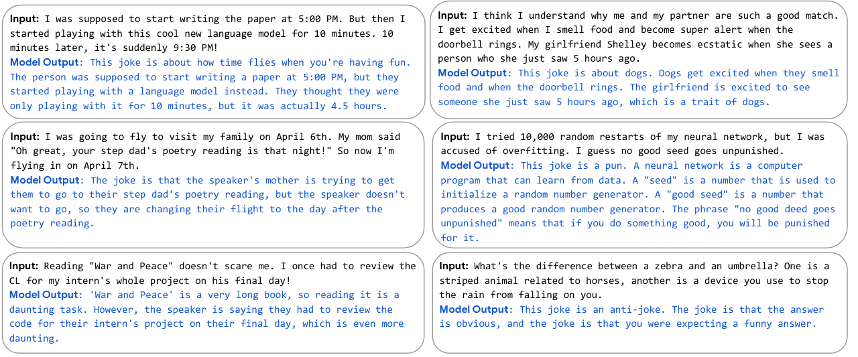
Prompting!
Source: The Tale of T0

Slide 70
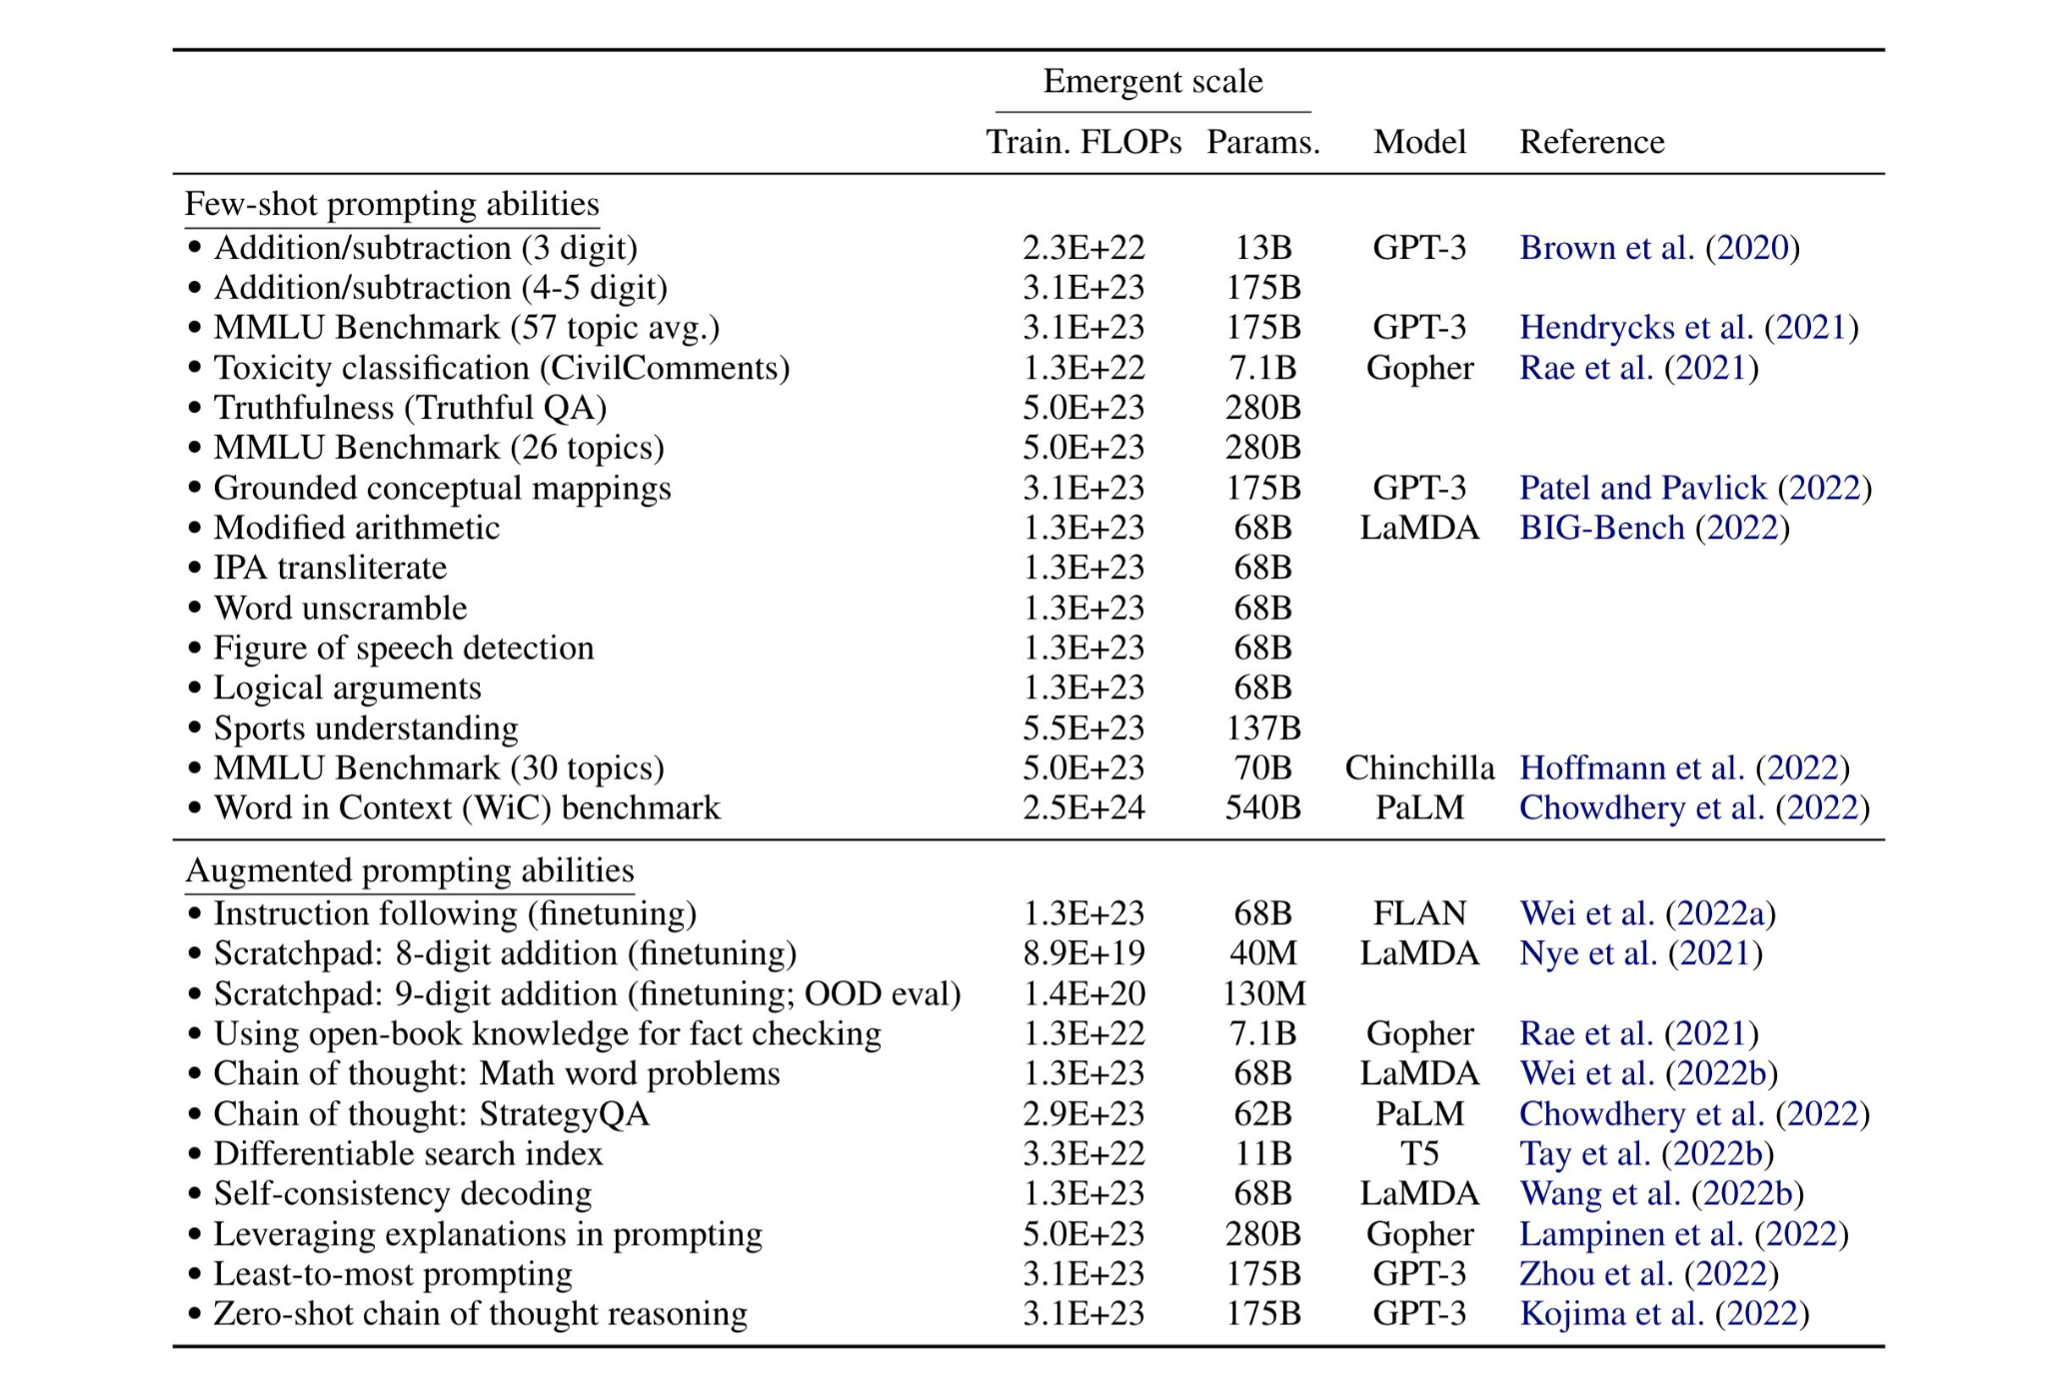
Prompting!
Source: Emergent Abilities of Large Language Models

Slide 71
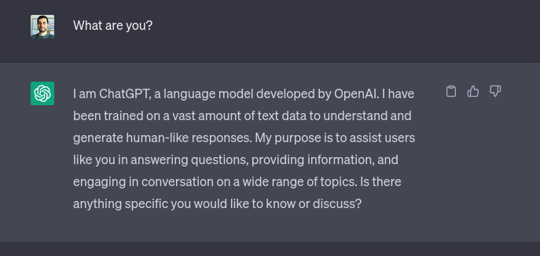
Prompting!

Slide 72
THANK YOU
https://bit.ly/clsinfra_embeddings
Javier de la Rosa, versae@nb.no National Library of Norway

